Slide 1
Designing Hadoop for the Enterprise Data Center
Jacob Rapp, Cisco
Eric Sammer, Cloudera

Slide 2
Agenda
Hadoop Considerations
  Traffic Types
  Job Patterns
  Network Considerations
  Compute
Integration
  Co-exist with current Data Center infrastructure
Multi-tenancy
  Remove the “Silo clusters”

Slide 3
Data in the Enterprise
Data Lives in a confined zone of enterprise repository
  Long Lived, Regulatory and Compliance Driven
Heterogeneous Data Life Cycle
  Many Data Models
  Diverse data – Structured and Unstructured
  Diverse data sources - Subscriber based
  Diverse workload from many sources/groups/process/technology
  Virtualized and non-virtualized with mostly SAN/NAS base
Call
Center
Sales
Pipeline
ERP
Module A
Doc
Mgmt A
Records
Mgmt
Doc
Mgmt B
Data
Service
Soc
Media
ERP
Module B
Office Apps
Video
Conf
Collab
Customer DB
(Oracle/SAP)
Product
Catalog
Catalog Data
VOIP
Exec
Reports
Scaling & Integration Dynamics are different
  Data Warehousing(structured) with diverse repository + Unstructured Data
  Few hundred to thousand nodes, few PB
  Integration, Policy & Security Challenges
Each Apps/Group/Technology limited in
  data generation
  Consumption
  Servicing confined domains
Notes:
Diverse data sources - Subscriber based
(Census, Proprietary, Buyers, Manufacturing)

Slide 4



















Enterprise Data Center Infrastructure
WAN Edge
Layer
FC SAN A
FC SAN B
MDS 9500
SAN
Director
Nexus 7000
10 GE Core
Layer 3
Layer 2 - 1GE
Layer 2 - 10GE
10 GE DCB
10 GE FCoE/DCB
4/8 Gb FC
Core Layer
(LAN & SAN)
Nexus 7000
10 GE Aggr
vPC+
FabricPath
L3
L2
Aggregation
& Services Layer
Network
Services
FC SAN A
FC SAN B
Access Layer
SAN Edge
Nexus
5500 FCoE
MDS 9200 /
9100
B22
FEX
HP Blade
C-class
Bare Metal
1G Nexus 3000
Top-of-Rack
Nexus 5500 10GE
Nexus 2148TP-E
Bare Metal
CBS 31xx
Blade switch
Nexus 7000
End-of-Row
Nexus 5500 FCoE
Nexus 2232
Top-of-Rack
UCS FCoE
Nexus 3000
Top-of-Rack
10G
1 GbE Server Access & 4/8Gb FC via dual HBA (SAN A // SAN B)
10Gb DCB / FCoE Server Access or 10 GbE Server Access & 4/8Gb FC via dual HBA (SAN A // SAN B)

Slide 5

Hadoop Cluster Design & Network Architecture

Slide 6
Validated 96 Node Hadoop Cluster
Nexus 7000
Nexus 7000
Nexus 5548
Nexus 5548
2248TP-E
Nexus 3000
Nexus 3000
2248TP-E
Name Node
Cisco UCS C200
Single NIC
Name Node
Cisco UCS C 200
Single NIC
…
…
…
…
Data Nodes 1 – 48
Cisco UCS C 200 Single NIC
Data Nodes 49- 96
Cisco UCS 200 Single NIC
Data Nodes 1 – 48
Cisco UCS C 200 Single NIC
Data Nodes 49 - 96
Cisco UCS C 200 Single NIC
Traditional DC Design Nexus 55xx/2248
Nexus 7K-N3K based Topology
Hadoop Framework
  Apache 0.20.2
  Linux 6.2
  Slots – 10 Maps & 2 Reducers per node
Compute – UCS C200 M2
  Cores: 12
  Processor: 2 x Intel(R) Xeon(R) CPU X5670 @ 2.93GHz
  Disk: 4 x 2TB (7.2K RPM)
  Network: 1G: LOM, 10G: Cisco UCS P81E
Network
  Three Racks each with 32 nodes
  Distribution Layer – Nexus 7000 or Nexus 5000
  ToR – FEX or Nexus 3000
  2 FEX per Rack
  Each Rack with either 32 single or dual attached host

Slide 7
Hadoop Job Patterns and Network Traffic

Slide 8
Job Patterns
Reduce
Ingress vs. Egress Data Set
1:0.3
Analyze
The Time the reducers start is dependent on:
mapred.reduce.slowstart.completed.maps
It doesn’t change the amount of data sent to Reducers, but may change the timing to send that data
Reduce
Ingress vs. Egress Data Set
1:1
Extract Transform Load
(ETL)
Reduce
Ingress vs. Egress Data Set
1:2
Explode

Slide 9




Traffic Types
Small Flows/Messaging
(Admin Related, Heart-beats, Keep-alive,
delay sensitive application messaging)
Small – Medium Incast
(Hadoop Shuffle)
Large Flows
(HDFS Ingest)
Large Incast
(Hadoop Replication)

Slide 10
Map and Reduce Traffic
NameNode
JobTracker
ZooKeeper
Many-to-Many Traffic Pattern
Map 1
Map 2
Map 3
Map N
Shuffle
Reducer 1
Reducer 2
Reducer 3
Reducer N
Output Replication
HDFS

Slide 11
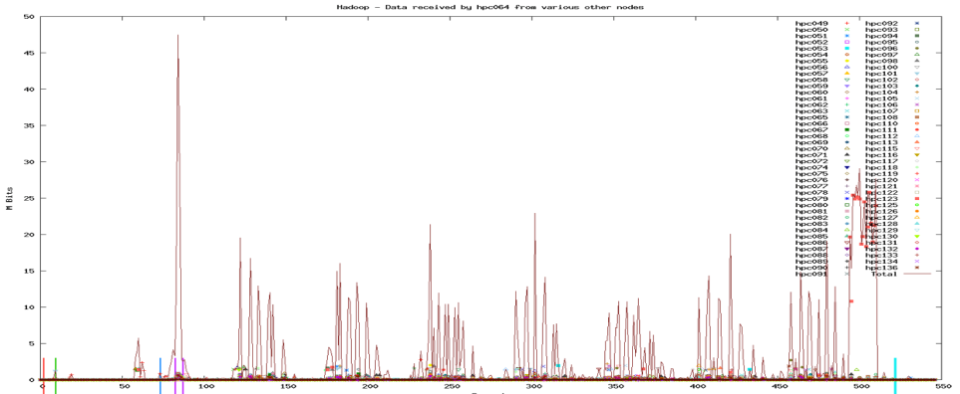
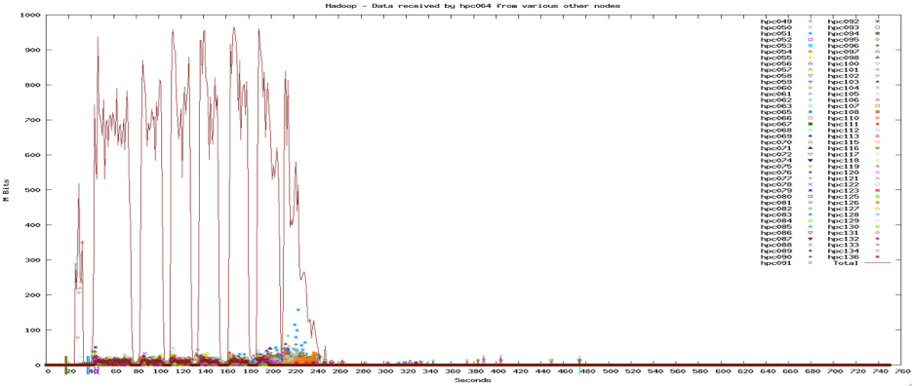
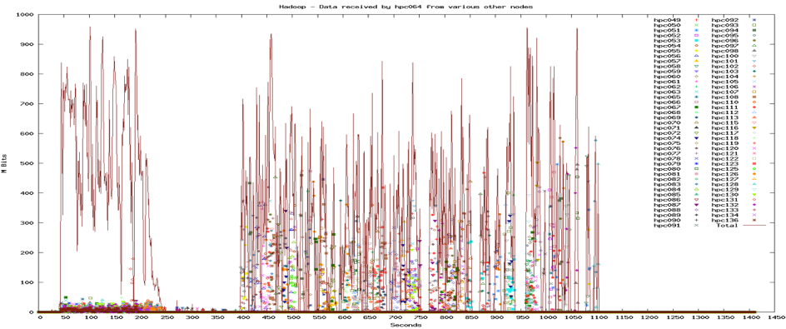
Job Patterns
Job Patterns have varying impact on network utilization
Analyze
Simulated with Shakespeare Wordcount
Extract Transform Load
(ETL)
Simulated with
Yahoo TeraSort
Extract Transform Load
(ETL)
Simulated with
Yahoo TeraSort with output replication

Slide 12
Data Locality in HDFS
Data Locality – The ability to process data where it is locally stored.
Note:
During the Map Phase, the JobTracker attempts to use data locality to schedule map tasks where the data is locally stored. This is not perfect and is dependent on a data nodes where the data is located. This is a consideration when choosing the replication factor. More replicas tend to create higher probability for data locality.
Map Tasks: Initial spike for non-local data. Sometimes a task may be scheduled on a node that does not have the data available locally.

Slide 13
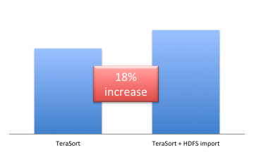
Multi-Job Cluster Characteristics
Hadoop clusters are generally multi-use. The effect of background use can effect any single job’s completion.
A given Cluster, running many different types of Jobs, Importing into HDFS, Etc.
Importing Data into HDFS
Large ETL Job Overlaps with medium and small ETL Jobs and many small BI Jobs
(Blue lines are ETL Jobs and purple lines are BI Jobs)
Example View of 24 Hour Cluster Use

Slide 14
Map to Reducer Ratio Impact on Job Completion
1 TB file with 128 MB Blocks == 7,813 Map Tasks
The job completion time is directly related to number of reducers
Average Network buffer usage lowers as number of reducer gets lower and vice versa.

Slide 15
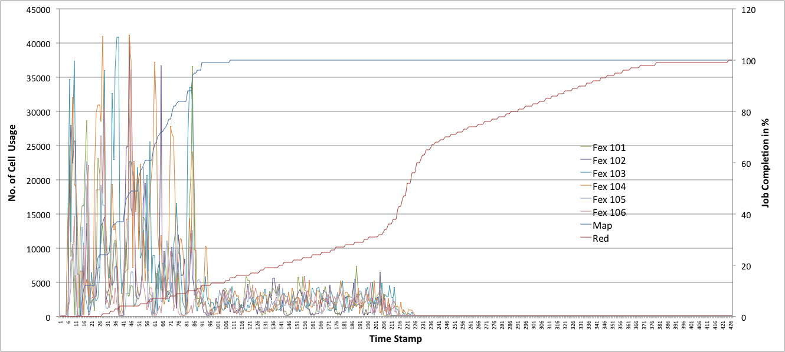
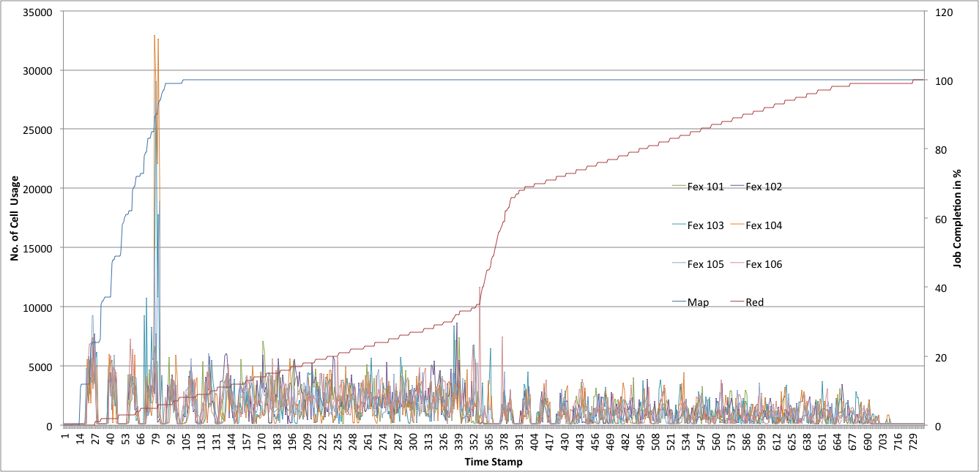
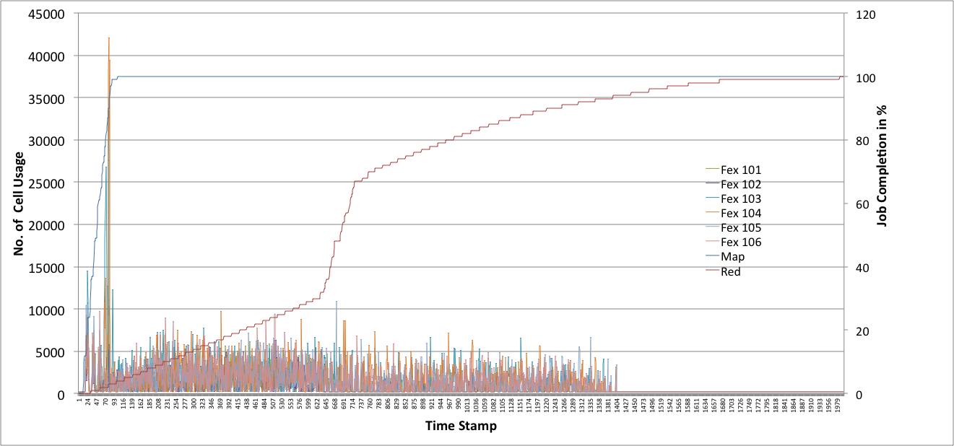
Network Traffic with Variable Reducers
Network Traffic Decreases with Less Reducers available
96 Reducers
48 Reducers
24 Reducers

Slide 16
Summary
Running a single ETL or Explode Job Pattern on entire cluster is the most network intensive jobs
Analyze Jobs are the least network intensive jobs
A mixed environment of multiple jobs is less intensive than one single job due to sharing of resources
Large number of reducers can create load on the network, but is dependent on Job Pattern and when reducers start

Slide 17
Integration into the Data Center

Slide 18
Integration Considerations
Network Attributes
Architecture
Availability
Capacity, Scale & Oversubscription
Flexibility
Management & Visibility

Slide 19
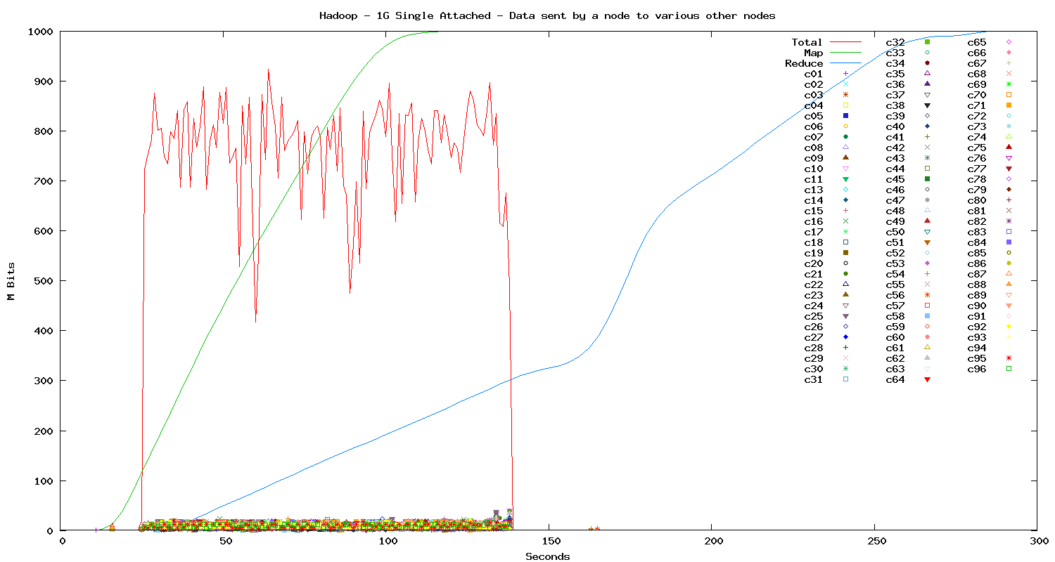
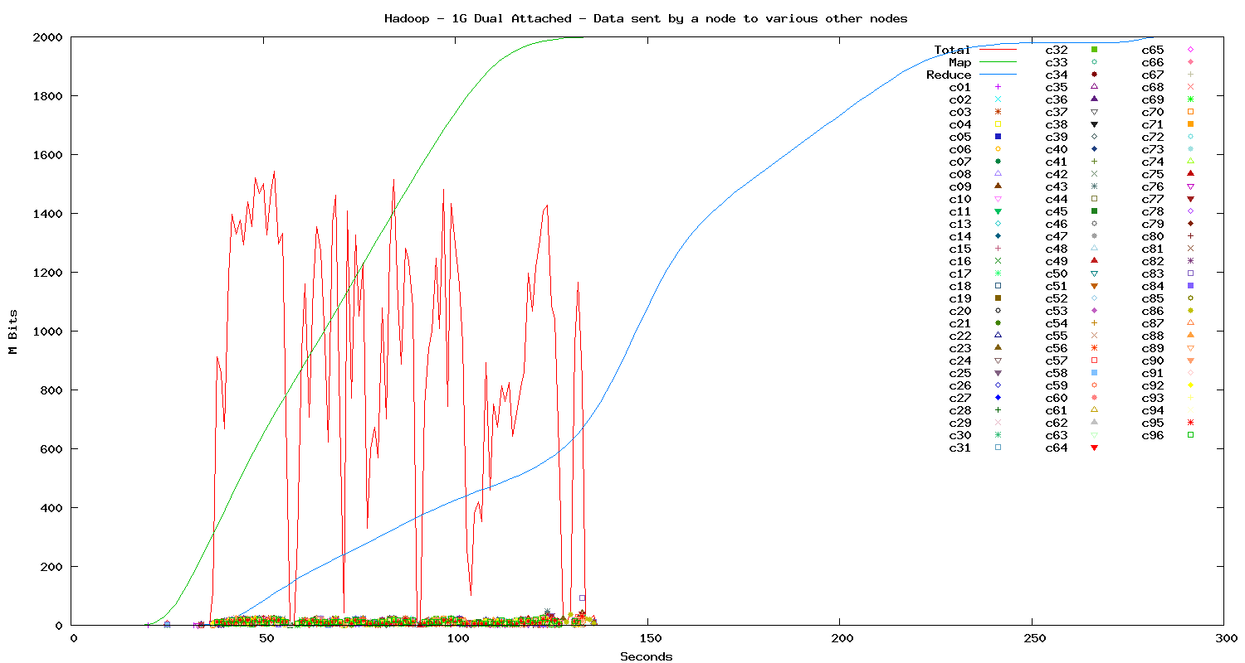
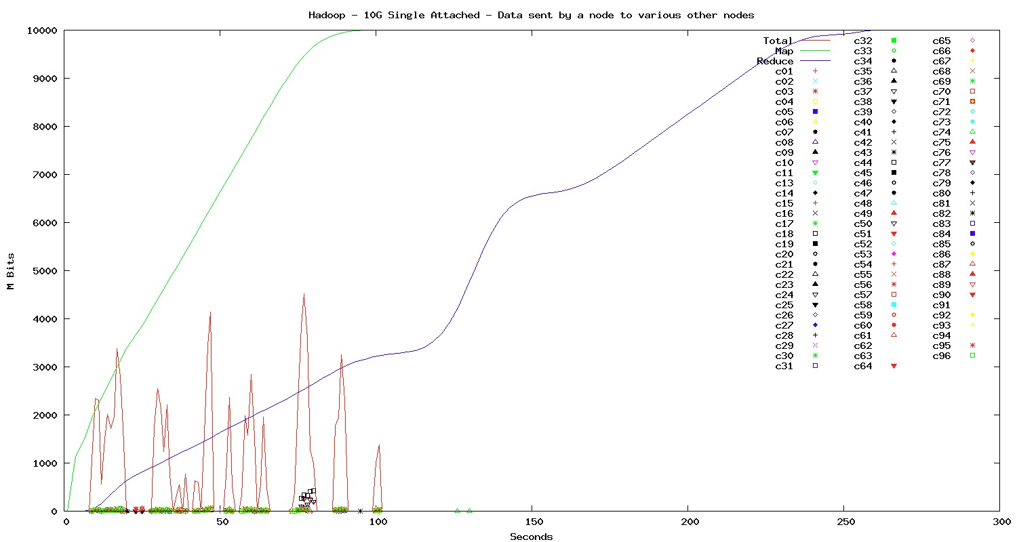
Data Node Speed Differences
Generally 1G is being used largely due to the cost/performance trade-offs. Though 10GE can provide benefits depending on workload
Single 1GE
100% Utilized
Dual 1GE
75% Utilized
10GE
40% Utilized
Notes:
Generally 1G is being used largely due to the cost/performance trade-offs. Though 10GE can provide benefits depending on workload
Reduced spike with 10G and smoother job completion time
Multiple 1G or 10G links can be bonded together to not only increase bandwidth, but increase resiliency.

Slide 20
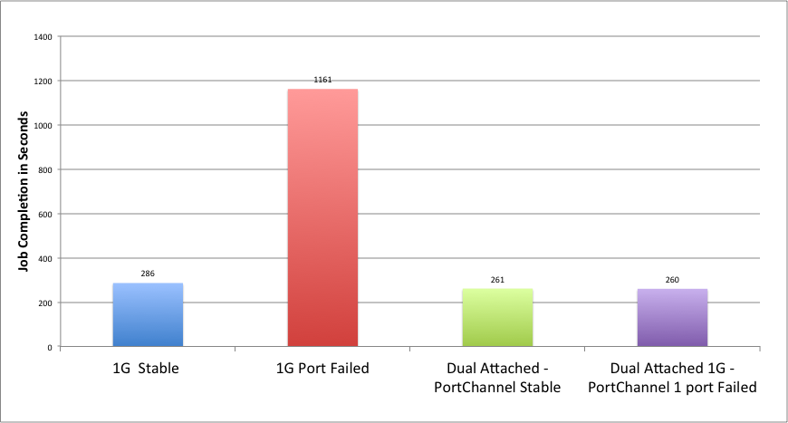
Availability
Single Attached vs. Dual Attached Node
No single point of failure from network view point. No impact on job completion time
NIC bonding configured at Linux – with LACP mode of bonding
Effective load-sharing of traffic flow on two NICs.
Recommended to change the hashing to src-dst-ip-port (both network and NIC bonding in Linux) for optimal load-sharing
Notes:
Talk about intensity of failure with smaller job vs bigger job
The MAP job are executed parallel so unit time for each MAP tasks/node remains same and more less completes the job roughly at the same time.
However during the failure, set of MAP task remains pending (since other nodes in the cluster are still completing their task) till ALL the node finishes the assigned tasks.
Once all the node finishes their MAP task, the left over MAP task being reassigned by name node, the unit time it take to finish those sets of MAP task remain the same(linear) as the time it took to finish the other MAPs – its just happened to be NOT done in parallel thus it could double job completion time. This is the worst case scenario with Terasort, other workload may have variable completion time.

Slide 21
1GE vs. 10GE Buffer Usage
Moving from 1GE to 10GE actually lowers the buffer requirement at the switching layer.
Buffer Usage During
Shuffle Phase
Buffer Usage During output Replication
By moving to 10GE, the data node has a wider pipe to receive data lessening the need for buffers on the network as the total aggregate transfer rate and amount of data does not increase substantially. This is due, in part, to limits of I/O and Compute capabilities

Slide 22
Network Latency
Generally network latency, while consistent latency being important, does not represent a significant factor for Hadoop Clusters.
Note:
There is a difference in network latency vs. application latency. Optimization in the application stack can decrease application latency that can potentially have a significant benefit.

Slide 23
Integration Considerations
Findings
10G and/or Dual attached server provides consistent job completion time & better buffer utilization
10G provide reduce burst at the access layer
Dual Attached Sever is recommended design – 1G or 10G. 10G for future proofing
Rack failure has the biggest impact on job completion time
Does not require non-blocking network
Latency does not matter much in Hadoop workloads
Goals
Extensive Validation of Hadoop Workload
Reference Architecture
  Make it easy for Enterprise
  Demystify Network for Hadoop Deployment
  Integration with Enterprise with efficient choices of network topology/devices
More Details at:
http://www.slideshare.net/Hadoop_Summit/ref-arch-validated-and-tested-approach-to-define-a-network-design
http://youtu.be/YJODsK0T67A

Slide 24
Multi-tenant Environments

Slide 25
Various Multitenant Environments
Hadoop + HBASE
Job Based
Department Based
Need to understand Traffic Patterns
Scheduling Dependent
Permissions and Scheduling Dependent

Slide 26
Hadoop + Hbase
Client
Client
Read
Update
Update
Read
Map 1
Map 2
Map 3
Map N
Region Server
Region Server
Shuffle
Read
Read
Reducer 1
Reducer 2
Reducer 3
Reducer N
Major Compaction
Major Compaction
Output Replication
HDFS

Slide 27
Hbase During Major Compaction
~45% for Read Improvement
Read/Update Latency
Comparison of Non-QoS vs. QoS Policy
Switch Buffer Usage
With Network QoS Policy to prioritize Hbase Update/Read Operations

Slide 28
Hbase + Hadoop Map Reduce
Read/Update Latency
Comparison of Non-QoS vs. QoS Policy
~60% for Read Improvement
Switch Buffer Usage
With Network QoS Policy to prioritize Hbase Update/Read Operations

Slide 29
Cisco.com Big Data
www.cisco.com/go/bigdata
THANK YOU FOR LISTENING
Cisco Unified Data Center
UNIFIED
FABRIC
UNIFIED COMPUTING
UNIFIED MANAGEMENT
Highly Scalable, Secure Network Fabric
Modular Stateless
Computing Elements
Automated
Management
Manages Enterprise Workloads
www.cisco.com/go/nexus
www.cisco.com/go/ucs
http://www.cisco.com/go/workloadautomation

